Slide 1

INDIAN INSTITUTE OF TECHNOLOGY,
GUWAHATI
DEPARTMENT OF MECHANICAL ENGINEERING
OPTIMIZATION METHODS IN ENGINEERING – ME 609
PROJECT PHASE – 3
CONSTRAINTS OPTIMIZATION WITH PENALTY METHOD
SUBJECT INSTRUCTOR: PROF. DEEPAK SHARMA
SUBMITTED BY:
NAME: OM CHOURASIA
ROLL NO: 224103217
NAME: SHAILESH KUMAR
ROLL NO: 224103222

Slide 2
Exhaustive search
The exhaustive search method can be used to solve problems where the interval in which the optimum is known to lie is finite.
The exhaustive search method consists of evaluating the objective function at a predetermined number of equally spaced points in the interval (a, b), and reducing the interval of uncertainty using the assumption of unimodality.
Interval halving method
In the interval halving method, exactly one half of the current interval of uncertainty is deleted in every stage.
Test whether the new interval of uncertainty, L = b - a, satisfies the convergence criterion L ≤ ϵ where ϵ is a small quantity. If the convergence criterion is satisfied, stop the procedure. Otherwise, set the new L₀ = L

Slide 3
Steepest descent
Steepest descent is search for a stationary point as an iterative procedure of generating a point x (k+1) which takes steps of certain length alpha at direction ∆x (k) from the previous point x (k) .
The direction ∆x (k) decides which direction we search next, and the step size determines how far we go in that particular direction. We can write this update rule as: x (k+1) = x (k) + alpha*∆x (k)

Slide 4
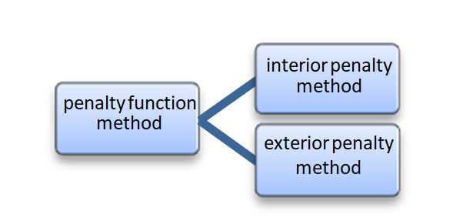
Penalty function method
The penalty method is one of the constrained optimization method . In this method if the constraint violated then objective functions get penalized .
Now the constraint transformed into the unconstraint problem by adding the penalty term of each constraint violation.
It works in the series of sequence and each time penalty added with new point obtained and form a sequence of series .
Penalty method are two types:
Interior & exterior penalty method
This method works for the feasible points and penalize points that are close to constraint boundary.
This methods penalize the infeasible points but not the feasible solutions

Slide 5
Start
Taking no of variables and initial guess as input
Forming Penalty function by converting constrained problem to unconstrained problem
Perform Steepest decent Method
Perform unidirectional search by converting multivariable problem to single variable problem and find solution by using Interval halving and Exhaustive search method
Check termination conditions
No
Yes
Optimum point
Print optimum point
End

Slide 6
QUESTION NO. 1
𝑚i𝑛 𝑓(𝗑) = (𝗑₁ − 10)³ + (𝗑₂ − 20)³
𝑔₁(𝗑) = (𝗑₁ − 5)² + (𝗑₂ − 5)² − 100 ≥ 0
𝑔₂(𝗑) = (𝗑₁ − 6)² + (𝗑₂ − 5)² − 82. 81 ≤ 0
13 ≤ 𝗑₁ ≤ 20, 0 ≤ 𝗑₂ ≤ 4
At initial guess X1 = 13, X2 = 4;
iteration fuction value
0 3946.5
1 4425.888806010495
2 4791.847822002934
3 87551.89831543191
4 909403.5468095964
5 29068.647069636714
6 3965.5745149745594
7 3968.4187464432366
8 3968.1161375575152
9 3858.305509986695
10 2428755.898751618
11 3574261067314575.0
12 4.888031220948628e+43

Slide 7
Problem_1 (R=0.1 and c=10)
Sr. No. | Initial Guess | Optimum Point | Number of iterations(sequence) | Function Value
1 | (15,4) | 6.19859729e+25 1.36660763e+26 | 9 | 5.0707946592097225e+113
2 | (14,0) | 6.02134385e+25 1.30972021e+26 | 9 | 4.3178048981681905e+113
3 | (17,2) | 1.12400446e+16 1.58669565e+17 | 9 | 6.402099018184364e+77
4 | (17,3) | 7.80805713e+28 1.71695082e+28 | 11 | 4.0849580098878293e+126
5 | (15,3) | 6.03641264e+25 1.31538205e+26 | 9 | 4.387402385415489e+113
6 | (18,2) | 5.50507627e+27 5.33920652e+27 | 9 | 3.4589679180703156e+120
7 | (19,1) | 2.79217710e+37 4.52675084e+36 | 10 | 6.401868432797283e+159
8 | (15,2) | 6.16989512e+25 1.35482907e+26 | 9 | 4.911710294988821e+113
9 | (19,2) | 4.58129937e+27 4.54426534e+27 | 9 | 1.7337772935457862e+120
10 | (14,3) | 3.37719339e+27 4.07760719e+27 | 9 | 7.85810720049371e+119

Slide 9
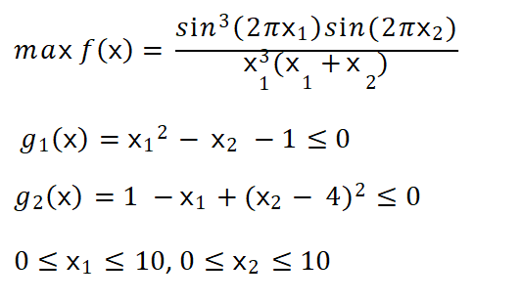
QUESTION NO. 2

Slide 10
At initial guess X1 = 4, X2 = 4;
iteration fuction value
0 16.900000000000002
1 0.0774523421697068
2 0.09549573719910402
3 91.73110666804266
4 827.3258221703712
5 0.005317899307956479
6 0.005394324664847115
7 0.005395889594413474
8 0.005394868676256047
9 0.00533614630642102
10 0.0015386450640549254
11 0.0015638319869603669
12 0.012744833278491416
13 0.08423142452675585
14 0.027946050981379006
15 0.028842854124991713
16 0.029068744341961352

Slide 11
Problem_2 (R=0.1 and c=10)
Sr. No. | Initial Guess | Optimum Point | Number of iterations(sequence) | Function Value
1 | (5,4) | 1.73576 4.75096 | 26 | -0.0291
2 | (2,5) | 2 5 | 0 | 0
3 | (3,7) | 1.82110984e+29 5.45360078e+27 | 20 | 1.0998790156714182e+137
4 | (5,5) | 1.73517 4.74225 | 8 | -0.0291
5 | (9,2) | 9.29733092e+22 4.29055723e+21 | 13 | 7.471970128225323e+104
6 | (7,3) | 1.00136 3.9631 | 7 | 0.0
7 | (4,2) | 1.44488 3.42175 | 6 | -0.0013
8 | (9,3) | 1.73657 4.74466 | 5 | -0.0291
9 | (3,2) | 1.45672261e+36 1.34755152e+35 | 17 | 4.503386790937661e+161
10 | (2,4) | 1.49727 4.00087 | 3 | 0.0

Slide 13
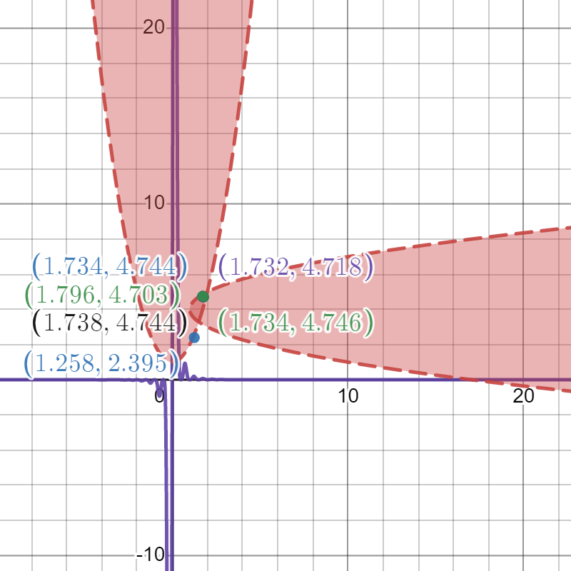

Slide 14
QUESTION NO. 3
𝑚i𝑛 𝑓(𝗑) = 𝗑₁ + 𝗑₂ + 𝗑₃
𝑔₁(𝗑) = −1 + 0. 0025(𝗑₄ + 𝗑₆) ≤ 0
𝑔₂(𝗑) = −1 + 0. 0025(−𝗑₄ + 𝗑₅ + 𝗑₇) ≤ 0
𝑔₃(𝗑) = −1 + 0. 01(−𝗑₆ + 𝗑₈) ≤ 0
𝑔₄(𝗑) = 100𝗑₁ − 𝗑₁𝗑₆ + 833. 33252𝗑₄ − 83333. 333 ≤ 0
𝑔₅(𝗑) = 𝗑₂𝗑₄ − 𝗑₂𝗑₇ − 1250𝗑₄ + 1250𝗑₅ ≤ 0
𝑔₆(𝗑) = 𝗑₃𝗑₅ − 𝗑₃𝗑₈ − 2500𝗑₅ +1250000 ≤ 0 100 ≤ 𝗑₁ ≤ 100
10 ≤ 𝗑_{i} ≤ 1000, i =4,5,6,7,8
1000 ≤ 𝗑_{i} ≤ 10000 , i =2,3
Due to the more no. of constraints it might be the penalty increases
too much and the function value coming very large.

Slide 15
Observation
Then minima of the function depends upon the initial guess .
When function converges to minima then penalty become zero.
First of all it minimize the function after that when R increases then it minimize Sequence of constraint which added with function by adding penalty.
In the some function at different initial guess first the function value increases after that it converges to minima after some iteration.
In some cases the function works very well and minimize after certain iteration.
Also with the change in the initial guess, only the number of iterations varied but the optimum point was almost the same

Slide 16
Conclusion
The penalty method is the best method used in constrained optimization which includes penalty for constraint violation .
The code was successful for problems involving less number of variables but was not able to give valid optimum points for problems having large number of variables.
Any constraint convex , concave , linear and non-linear can be handled.

